Slide 1

Topic:
“Predictive Analysis for Travel Insurance” through Machine Learning.

Slide 2




Greetings to all guests for our presentation on "Predictive Analysis for Travel Insurance through Machine Learning“
Our project aims to use the database history of around 101001 former clients from a well- known tours and travel company to forecast their potential interest in purchasing travel insurance in the future. We seek to develop an intelligent model capable of predicting a customer's likelihood to purchase the travel insurance package based on specific characteristics.
These variables comprise the client's age, profession, level of education, yearly income, size of family, frequency of travel, health condition, past international travel history, and number of prior travel insurance purchases.
We will explore the important steps used to examine the data, identify significant trends , and to create predictive models throughout the session. Upon completion, you will have a deeper understanding of the variables impacting consumer reactions and how these understandings can inform focused marketing tactics.

Slide 3



Importance of Travel Insurance
Financial Safety Net
Travel insurance provides a safety net in the event of unexpected events, ensuring that passengers won't be stranded paying high medical costs or suffer financial loss caused due to cancelled flights.
Peace of Mind
It provides peace of mind, allowing travelers to enjoy their trip knowing they are protected against unexpected mishaps.
Emergency Assistance
It includes access to emergency assistance services such as medical evacuations or repatriation, in the event of a medical emergency

Slide 4
Overview of Machine Learning
Data Analysis
Machine learning involves using algorithms to analyze and interpret complex data sets, enabling the discovery of meaningful patterns and insights.
Pattern Recognition
It focuses on training computer systems to identify patterns and make decisions based on data, leading to more accurate predictions and outcomes
Customized Recommendations
Machine learning enables the customization of travel insurance options based on individual travel patterns and preferences, enhancing coverage and satisfaction
Risk Mitigation
It helps in identifying and mitigating potential risks through the analysis of historical data and real-time information, leading to more accurate risk assessments and appropriate coverage.

Slide 5
Data Collection
We have taken the data from Capstone project, which consists of ten columns, for this research.
Descriptive Statistics:
Number of Rows-101001
Number of Columns-10
Key Input Variables:
Age - The customer's age
Employment Type - The Industry in which the customer works
Graduate or Not - This refers to the customer's status as a college graduate
Annual Income - The customer's annual income expressed in Indian rupees
Family Member -The customer's Family size
Chronic Diseases-To know if the customers has any serious medical conditions
Frequent Flyer -To know how many customer are a frequent traveler
Ever Travelled Abroad -To know if the customers ever traveled overseas
Travel Insurance - To know if the customers bought the Travel Insurance
Outcome variable:
Binary Classification task determining whether the customer possesses travel insurance. (0 and 1)

Slide 6
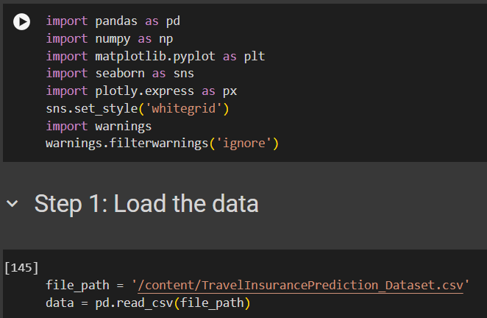
To Read Data:

Slide 7
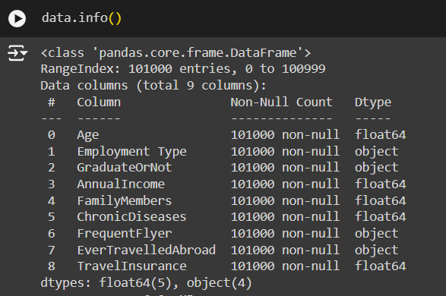
To Understand the Data:

Slide 8
Data Preprocessing
After receiving the data, certain modifications were implemented to clean it up.
Handling Missing Values :
The dataset underwent filtration to identify discrepancies or missing values. No gaps or missing data were identified.
Removing Column :
An unnamed column was identified and removed during subsequent machine learning analysis, and its indexing for dashboard presentation was adjusted to start at 1 instead of 0.
Converting data :
Additionally, four columns, namely (Employment Type, Graduate or Not, Frequent Flyer and Ever Travelled Abroad) indicating categorical data, were converted to numerical format by using one hot encoding method to enhance clarity and improve model performance.

Slide 9
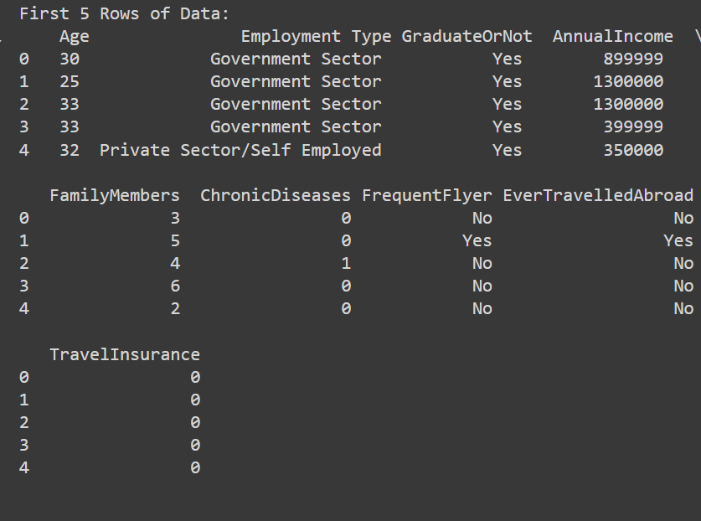
After Preprocessing, Please find few rows of the dataset:

Slide 10
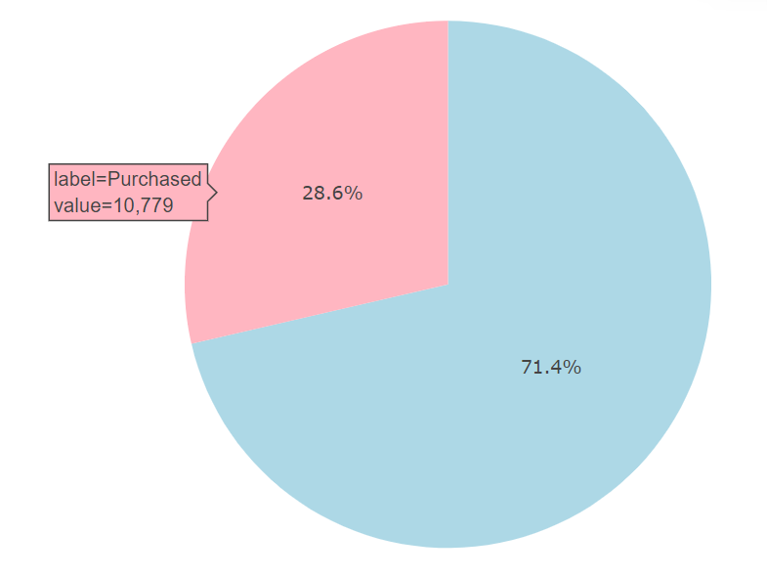
Illuminating Patterns and Trends
Visualization in machine learning not only aids in understanding data and model behavior but d facilitates effective communication of results to stakeholders. It helps make informed decisions. troubleshoot issues, and build trust in machine learning models.
Out of the company’s 37,652 customers, only 28.6% opted to purchase the travel insurance package and 71.4% of people have not bought the travel insurance.
Label=Not Purchased
Value= 26,883

Slide 11
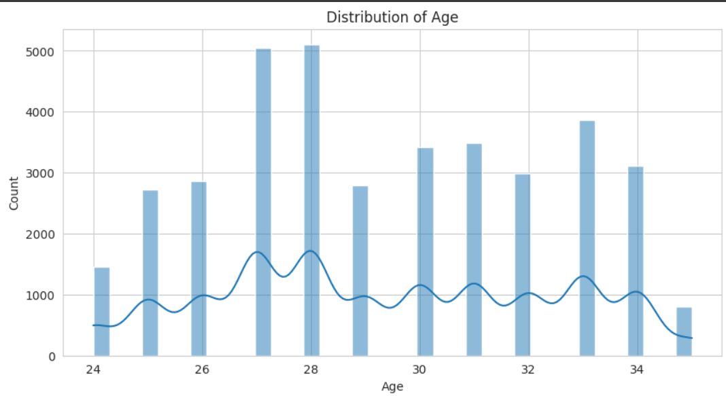
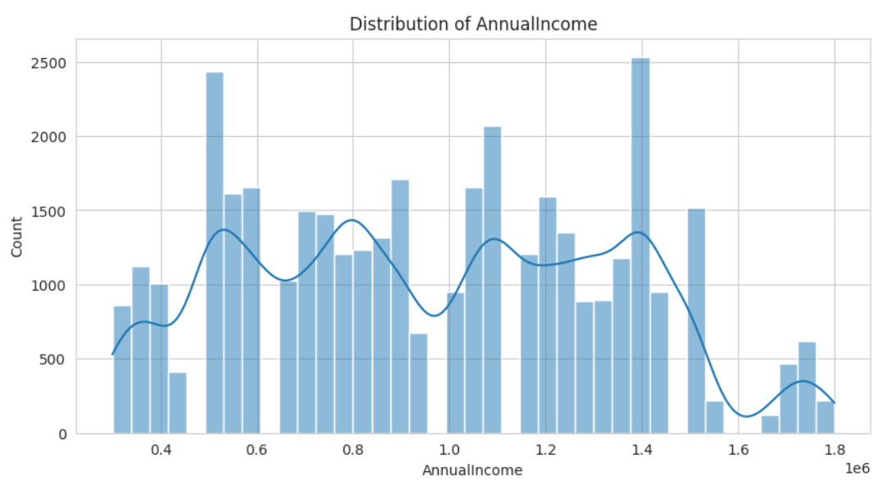
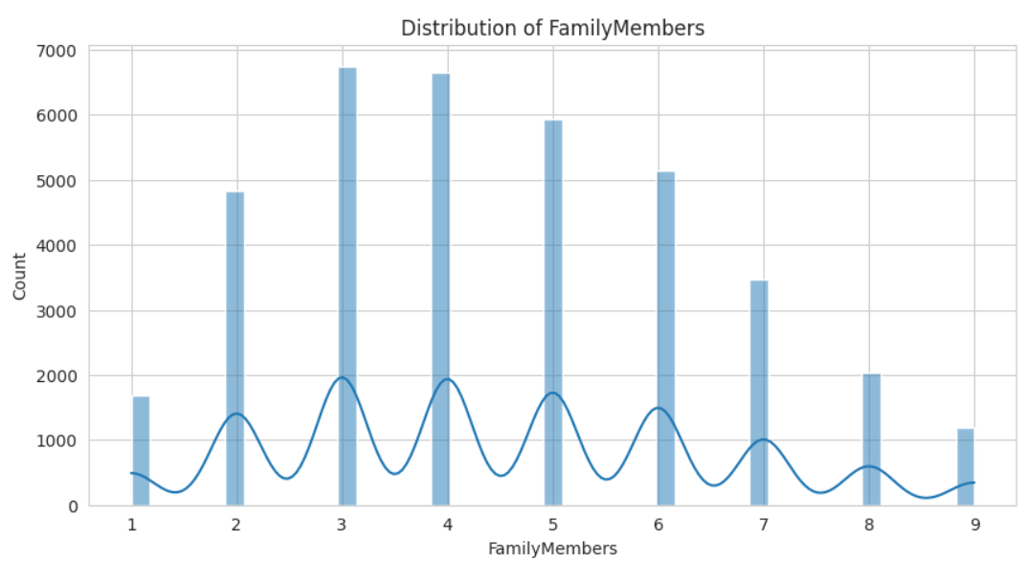
Check data distribution:
Findings: Based on the graph, the type of data distribution on the numerical features tends to be normal

Slide 12
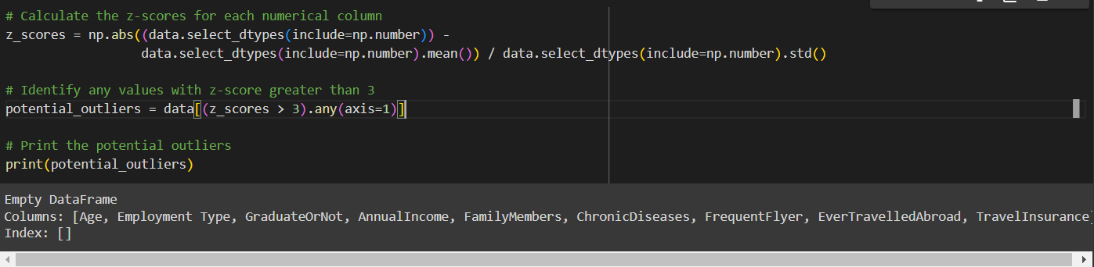
Outlier Detection:
As per Findings, There are no potential outliers in the dataset.

Slide 13
Model Training and Evaluation Process:
Data Splitting:
The dataset is divided into training, validation, and testing sets to ensure unbiased model evaluation.
Model Training:
Utilization of various machine learning models to identify the most fitting algorithm for the prediction task.
Evaluation Metrics:
Measuring model performance using metrics like accuracy, precision, recall, and F1 score.

Slide 14
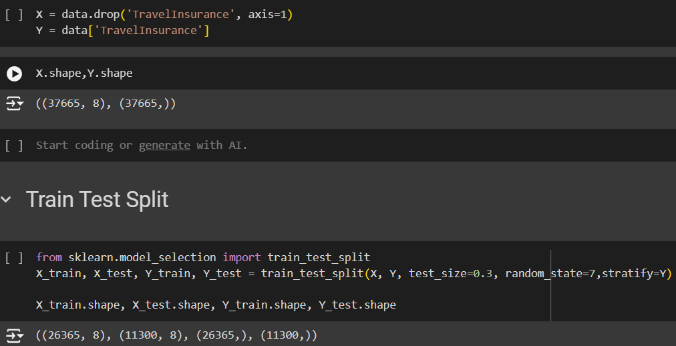
Separating out the Target variable and and then Training and Testing Data:

Slide 15
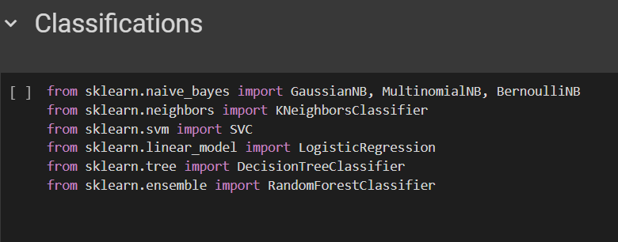
Below mentioned Classification algorithm used to find out Accuracy of the dataset:

Slide 16
Model Comparison:
Sr. No. | Models | Accuracy
1 | BernoulliNB() | 71%
2 | GaussianNB() | 71%
3 | K-Nearest Neighbors (KNN) | 65%
4 | MultinomialNB() | 65%
5 | Support Vector Machines (SVM) | 63%
6 | Random Forest Classifier | 57%
7 | DecisionTreeClassifier | 52%
8 | LogisticRegression | 29%
As per Observation, BernoulliNB and GaussiaNB algorithm gives the best accuracy 71%

Slide 17
Conclusion:
We applied six different classification models, including Logistic Regression(LR), Decison Tree(DT), Random Forest(RF), K-Nearest Neighbor(KNN), Naive Bayes(NB), and Support Vector Machines(SVC) to classify the data and determined that the Naive Bayes(NB) algorithm provided the best accuracy score of 71%, making it the recommended model for further use.

